Slide 1

CONSULTANCY PROJECT BASED ON BARTER SYSTEM
Project supervisor: Dr. Praveen Lalwani
Project reviewers: Dr. V Pandimurugan
Dr. Prashant G K

Slide 2
TEAM MEMBERS
Shikhar Pandey – 19BCE10036
Vedant Agrawal – 19BCE10057
Shreyash Singh – 19BCY10066
Patnala Saikiran – 19BCY10103
Shivam Agrwal – 19BCY10140
Krishna Agrawal – 19BCY10177
Mayank Nath Tiwary – 19BME10034
Naman Arora - 19MIM10057

Slide 3

INTRODUCTION
Why are we making this project?
Thoughts behind our Project.
How are we going to divide our project?

Slide 4
BARTER SYSTEM
Barter is an act of trading goods or services between two or more parties without the use of money or a monetary medium, such as a credit card.
In essence, bartering involves the provision of one good or service by one party in return for another good or service from another party.
A simple example of a barter arrangement is a carpenter who builds a fence for a farmer. Instead of the farmer paying the builder $1,000 in cash for labor and materials, the farmer could instead recompense the carpenter with $1,000 worth of crops or foodstuffs.

Slide 5
Continued…
Bartering is based on a simple concept: Two individuals negotiate to determine the relative value of their goods and services and offer them to one another in an even exchange.
It is the oldest form of commerce, dating back to a time before hard currency even existed.
Virtually any item or service can be bartered if the parties involved agree to the terms of the trade. Individuals, companies, and countries can all benefit from such cashless exchanges, particularly if they are lacking hard currency to obtain goods and services.

Slide 6
Benefit of barter system
Bartering allows individuals to trade items that they own but are not using for items that they need, while keeping their cash on hand for expenses that cannot be paid through bartering, such as a mortgage, medical bills, and utilities.
Bartering can have a psychological benefit because it can create a deeper personal relationship between trading partners than a typical monetized transaction. Bartering can also help people build professional networks and market their businesses.

Slide 7
LITERATURE REVIEW
Since the beginning of human history, people have been trading directly in goods and services in a trading system called trading.
The history of trade dates back to 6000 BC. Introduced by the Mesopotamian tribes, the trade was adopted by the Phoenicians.
Traditionally, trading systems were used in the local community.
For example, a farmer with eggs and milk may sell a baker to a local baker for a birthday cake and bread. The baker then uses milk and eggs to bake more bread, which he gives to an electrician to pay for his oven.

Slide 8
PREVIOUS WORK DONE
There hasn't been much development in the area of barter system
There are certain websites and mobile applications using the barter system but they weren't able to attract many clients.
Our application would be more user friendly in order to attract more users and make use of the barter system more often.
Some of the available barter system applications are TradeMade, SwopIt, Freecycle etc.

Slide 9
TradeMade application
It is a mobile application in which you can upload you items or services that you are willing to provide in exchange with you desired product.
You can also view you desired product according to different brands.
It is a very simple application in which you have to just click on your desired product and address and you can get the product at you house.

Slide 10

MODULE DESCRIPTION
Modules provide a container for the app's source code, resource files, and app level settings, such as the module-level build file and Android manifest file.
Each module can be independently built, tested, and debugged.
We will be using application module in our application

Slide 11
APPLICATION MODULE
An application module is a class that represents a business application task.
It encapsulates the data model associated with a task, plus the custom code to implement the task.
An application module contains code to implement a task.

Slide 12
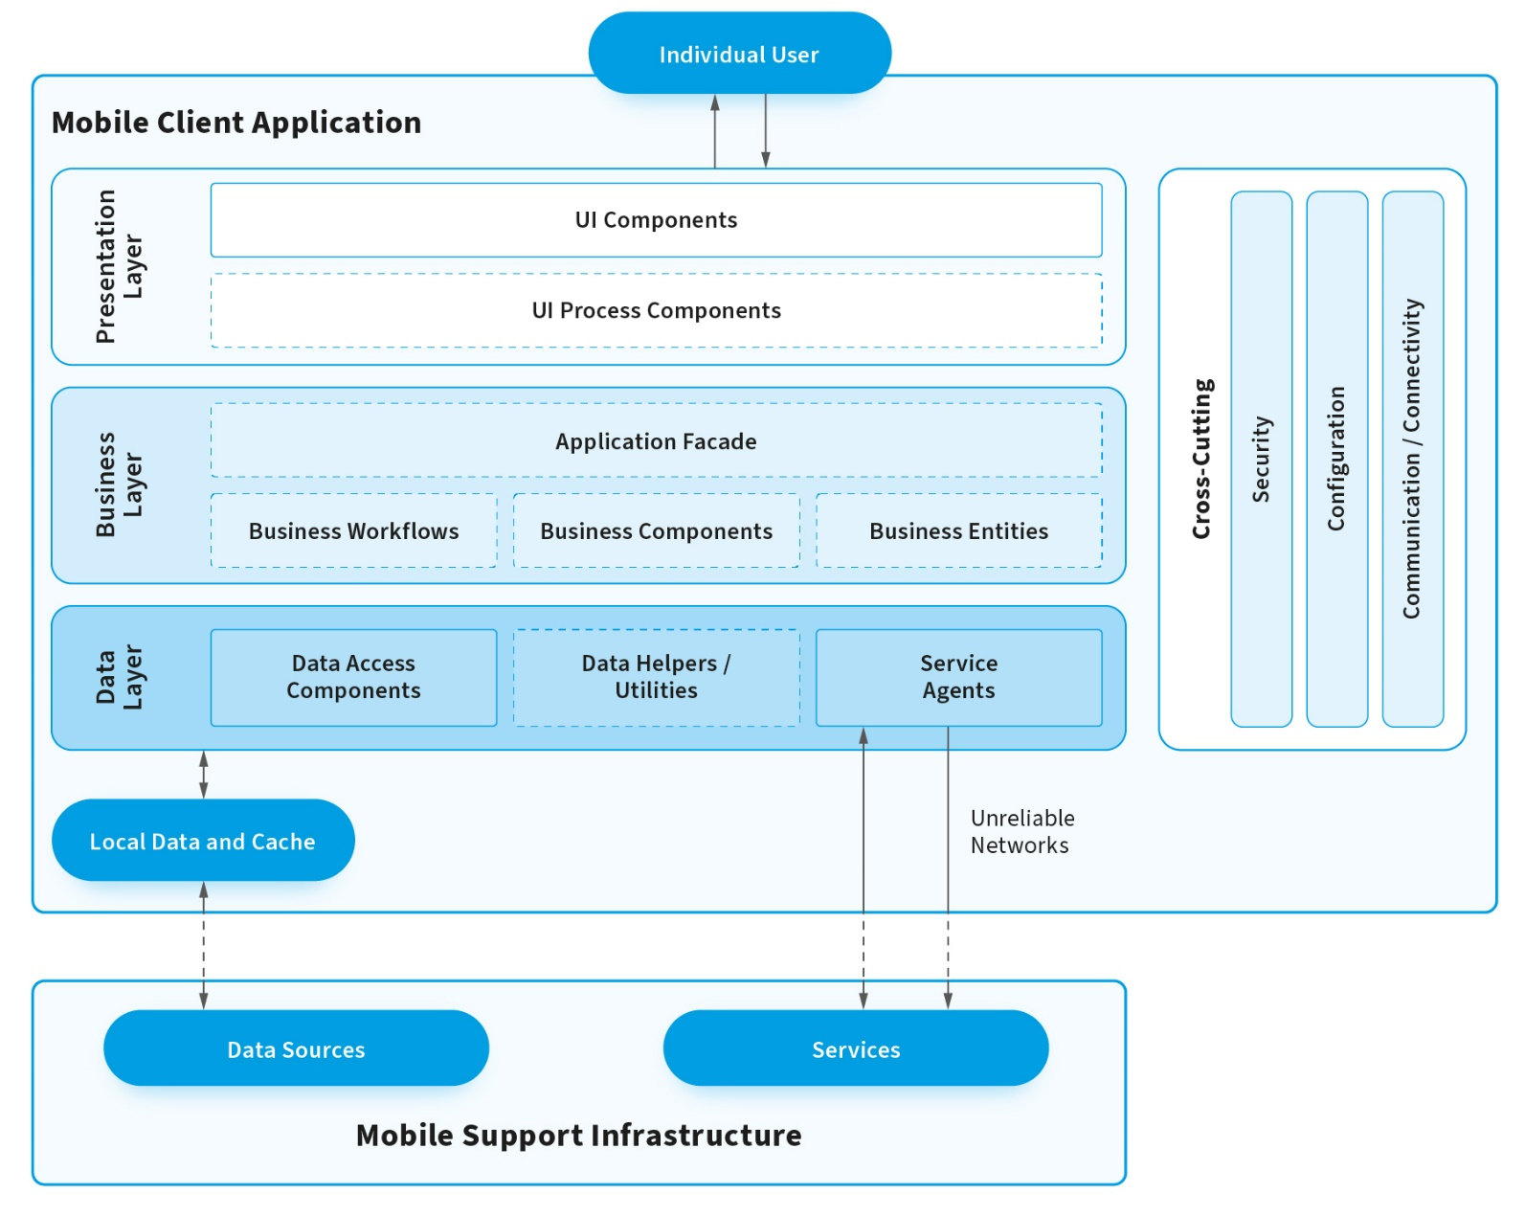
WORKING ARCHITECTURE OF AN APP

Slide 13
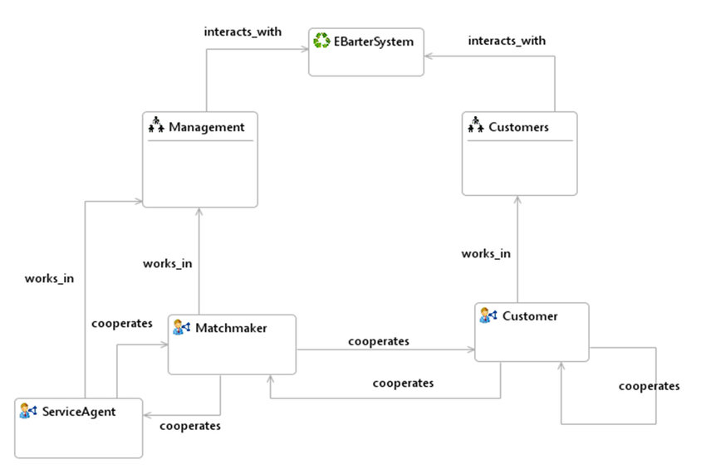
WORKING ARCHITECTURE OF BARTER SYSTEM

Slide 14
HARDWARE REQUIREMENTS
Microsoft Windows 7/8/10 (32 or 64 bit).
2GB RAM, 4GB RAM recommended.
500 MB disk space
Android SDK.
Java Development Kit (JDK) 7.

Slide 15
SOFTWARE REQUIREMENTS
JAVA
ANDROID STUDIO

Slide 16
CONCLUSION
The application we're trying to make will be helpful to a lot of people.
Without the involvement of money or bank, people will get the things they need in exchange with something of their own.
The application will be user friendly and easy to use so that each and everyone can benefit from it.

Slide 17
REFERENCES
Overview of E-Barter MAS. | Download Scientific Diagram (researchgate.net)
Application Architecture for a Mobile App: iOS, Android, Hybrid – NIX United (nix-united.com)
What Is an Application Module? (oracle.com)
What Is an Application Module (oracle.com)
3 Best Apps + Websites for Trading, Bartering & Swapping Stuff | TradeMade, Inc. 2020 | A Trade & Barter App, With A Cause (trademade-app.com)

Slide 18
THANK YOU

